Slide 1

Real-Time GPS-Free Underground Worker Tracking System
ESP32, BLE, IMU & Django Implementation
Technical Implementation GuideFor Mining & Cave Operations

Slide 2


Critical Problem: Worker Safety Underground
GPS Blackout Zones
Cost Barriers
Underground mines and caves completely block GPS signals, leaving workers invisible to surface monitoring systems.
Commercial indoor tracking solutions cost $5,000-15,000 per worker, making them prohibitive for smaller mining operations.
Safety Risk
Technical Gaps
Without real-time location data, emergency response times increase dramatically during accidents or cave-ins.
Existing systems require extensive infrastructure or specialized hardware incompatible with harsh underground conditions.
Sensor Fusion
Peer BLE Mesh
Cloud Dashboard
Edge Processing

Slide 3
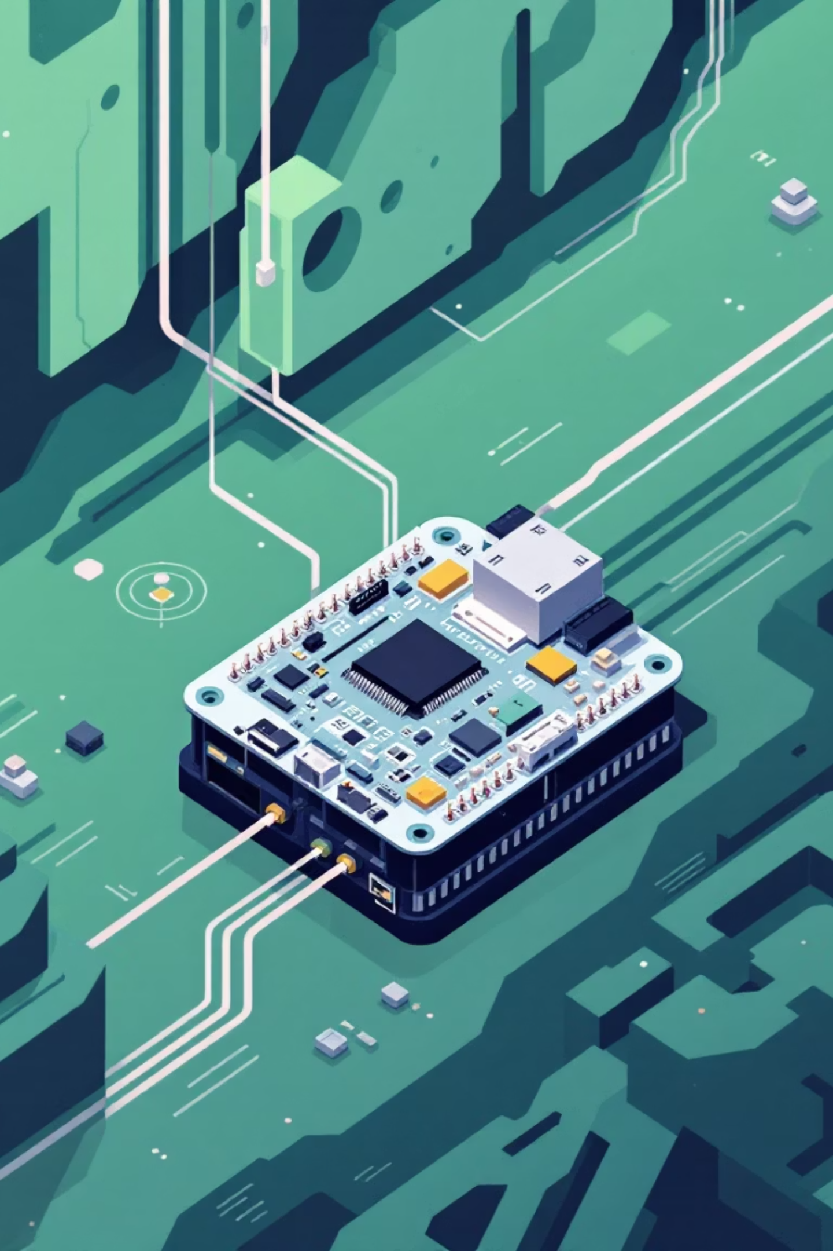





Solution Objective
Sensor Node
Server & UI
Local Positioning
Edge Gateway
Real-Time Tracking
Cost-Effective Design
Continuous location monitoring with sub-2-meter accuracy using BLE signal triangulation and IMU sensor fusion.
Total system cost under ₹1,500 per worker using ESP32 microcontrollers and open-source software stack.
GPS-Independent
Fully autonomous indoor positioning using Bluetooth Low Energy beacons and inertial measurement units.

Slide 4

System Architecture Overview
ESP32 Tags
BLE Beacons
WiFi Gateway
Python Processor
Workers wear ESP32 tags that scan fixed BLE beacons and collect IMU motion data. The Django backend processes location algorithms and serves real-time coordinates to the monitoring dashboard.

Slide 5




Hardware Components & Specifications
ESP32 Dev Board
MPU6050 IMU
₹300 - Dual-core processor with built-in WiFi/BLE. Handles beacon scanning, IMU data collection, and wireless transmission to backend systems.
₹150 - 6-axis accelerometer and gyroscope. Provides motion detection, orientation tracking, and helps estimate movement direction between beacon readings.
BLE Beacons
Power System
₹300-600 - Fixed reference points throughout the underground facility. Continuously broadcast identification signals for triangulation positioning.
₹200 - Rechargeable Li-ion battery pack with 8-12 hour operation. Includes charging circuit and low-power sleep modes for extended runtime.

Slide 6




Software Stack Implementation
ESP32 Firmware
C++ code handles BLE scanning, MPU6050 data acquisition, and WiFi transmission. Implements power management and error handling for continuous operation.
Data Processing Script
Python service reads serial/WiFi data from ESP32 devices, applies RSSI-to-distance algorithms, and forwards processed location data to Django REST API.
Django Backend
REST API stores worker locations in MySQL with timestamps. Implements real-time data validation, device management, and historical tracking queries.
Real-Time Dashboard
Web-based interface displays live worker positions on 2D facility maps. Updates every 2-3 seconds with WebSocket connections for minimal latency.

Slide 7

BLE + IMU Data Collection Process
Beacon Scanning
{ "device_id": "ESP32_001", "timestamp": 1703025600, "beacons": [ {"id": "BEACON_A", "rssi": -45}, {"id": "BEACON_B", "rssi": -62} ], "imu": { "accel": [0.2, 9.8, -0.1], "gyro": [0.05, -0.02, 0.0] }}
ESP32 continuously scans for nearby BLE beacons, recording RSSI values and beacon IDs every 500ms.
Motion Tracking
MPU6050 samples acceleration and gyroscope data at 100Hz, detecting worker movement patterns and orientation changes.

Slide 8




Django Backend Architecture
REST API Endpoints
MySQL Schema
Position Algorithm
/api/track/ receives location data/api/workers/ manages device registry/api/history/ provides location history
Worker locations table with device_id, coordinates, timestamp, and raw sensor data stored as JSON fields.
Trilateration using RSSI-to-distance conversion with IMU-based movement prediction for improved accuracy.

Slide 9
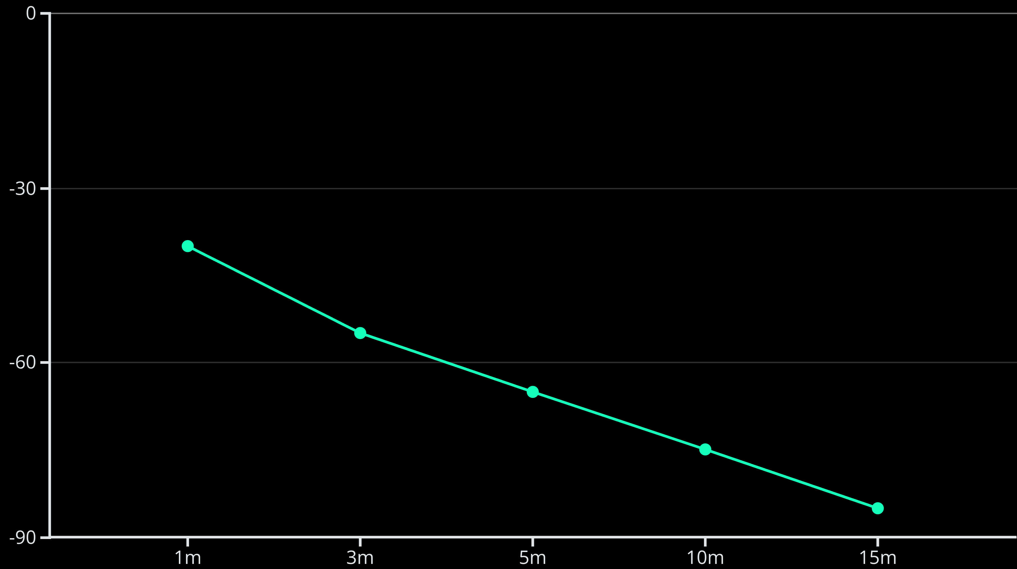
System Performance & Accuracy
1.5M
2-3
8-12
Positioning Accuracy
Update Frequency
Battery Life
Average location error within underground test environment using 4+ beacon triangulation
Seconds between location updates with real-time WebSocket dashboard refresh
Hours of continuous operation with optimized power management and sleep modes

Slide 10



Implementation Results & Next Steps
Proven Cost Savings
Significant cost savings: ₹1,500 per worker vs. ₹50,000+ for commercial UWB, a 97% reduction while maintaining essential safety functionality.
Future Enhancements
97%
ML algorithms for drift correction & improved accuracy
Emergency SOS button with auto-alerts
Predictive battery maintenance alerts
Mobile app for field deployment
Cost Reduction
Compared to commercial indoor tracking solutions
85%
Implementation Success
System uptime in underground test environment
Ready for production deployment in mining, cave exploration, and emergency response where GPS is impossible.

